Slide 1
Capacitors and supercapacitors
Fyodor Malchik

Slide 2
Overview
History of Capacitors
Electrolytic Capacitors
History of Supercapacitors
Double Layer Electrolytic Capacitor
Battery vs. Supercapacitor
Application of Supercapacitors

Slide 3
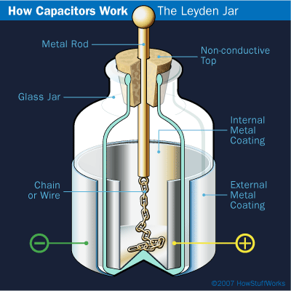
History of Capacitors
In 1740, Ewald Georg von Kleist constructed the first capacitor.
In the same year Pieter von Musschenboek invented the Leyden Jar.
Ben Franklin soon found out a flat piece of glass can be used in place of the jar model

Slide 4
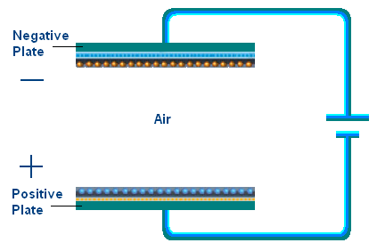

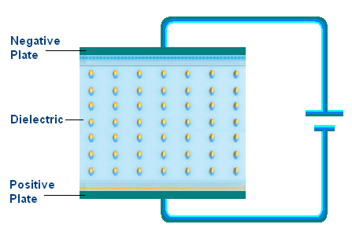
Electrolytic Capacitors
Two parallel plates with dielectric in between
Capacitance limited by flat surface area and dielectric properties
  C is the capacitance
  A is the area
  εr is the relative static permittivity (dielectric constant)
  εo is the permittivity of free space (8.854x10-12 F/m)
  d is distance

Slide 5
History of Super Capacitors
The Electric Double Layer Capacitor effect was first noticed in 1957 by General Electric.
Standard Oil of Ohio re-discovered this effect in 1966.
Standard Oil of Ohio gave the licensing to NEC, which in 1978 marketed the product as a “supercapacitor”.

Slide 6
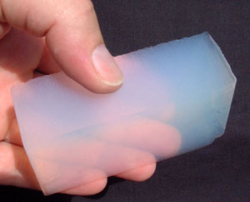
Carbon Aerogel
- Aerogel is a low-density solid derived from gel that has had the liquid component replaced with a gas.
Composed of nanometer sized particles covalently bonded together
High porosity (>50% under 100 nm)
Large surface area (400–1000 m²/g)

Slide 7
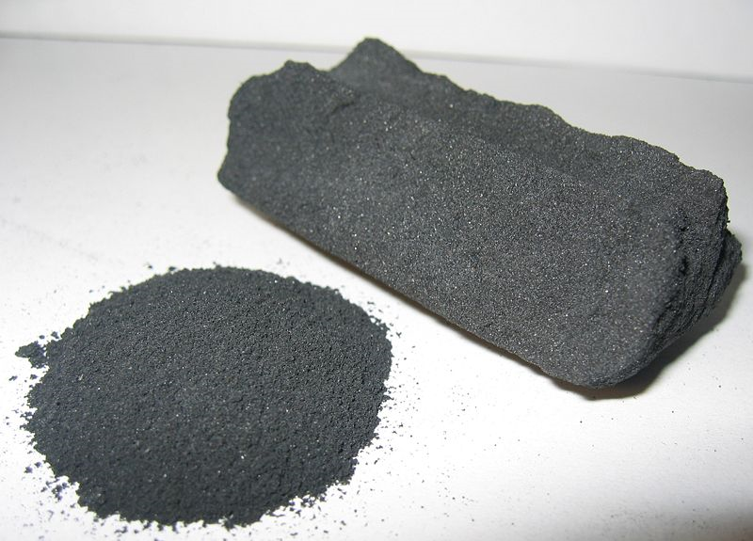
Activated Carbon:
Extremely porous with a very large surface area.
Surface resembles a sponge.
Area allows more electrons to be stored than other conductors.
Activated Carbon
( Activated Charcoal )

Slide 8
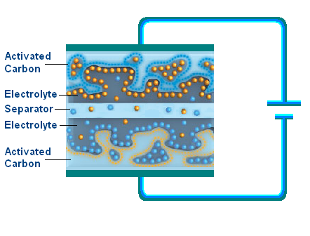
Double Layer Electrolytic Capacitors
Using Activated Carbon
Two layers consisting of nanoporous electrodes
Separator is impregnated with an organic electrolyte
Thin separator can only withstand low voltages

Slide 9
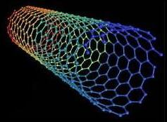
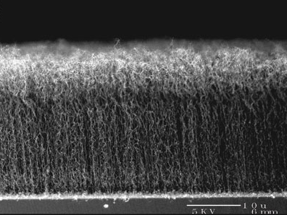
Carbon Nanotubes
Approximately 1/50,000th the width of a human hair
Strongest and stiffest material on earth (>300 X Steal)
Low density
Semiconductor

Slide 10
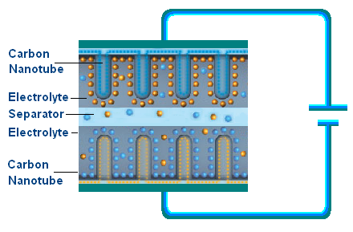
Double Layer Electrolytic Capacitors Using Carbon Nanotubes
Under development at MIT
Replaces activated charcoal with carbon nanotubes
Aligned in a regular pattern that exposes greater surface area
Dramatically increases effective area of electrodes
Greatly increases power density

Slide 11
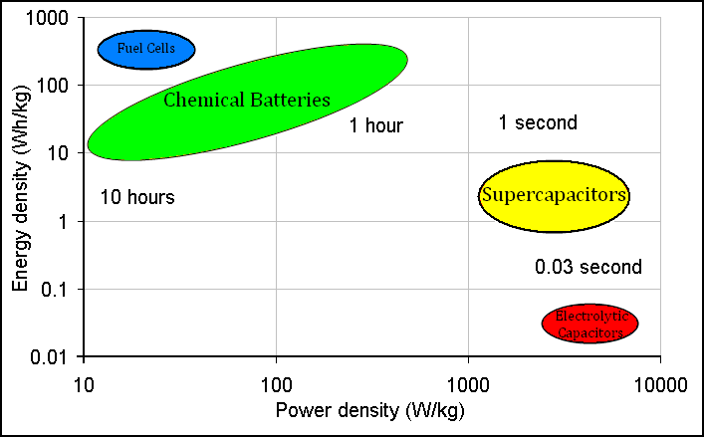
Comparing Batteries & Supercapacitors
Energy density is the amount of energy stored per unit volume or mass.
Power density combines energy density with the speed that
energy can be drawn out of a device.

Slide 12
Rechargeable Batteries Vs. Supercapacitors
Supercapacitors:
Higher power density
Much faster charge and discharge rate
Environmentally friendly
Extremely low internal resistance or ESR
High efficiency (97-98%)
Over a million charge-discharge cycles
Batteries:
Have higher energy density
Typically 200–1000 charge-discharge cycles
Contain highly reactive and hazardous chemicals
Negatively effected by low temperatures

Slide 13
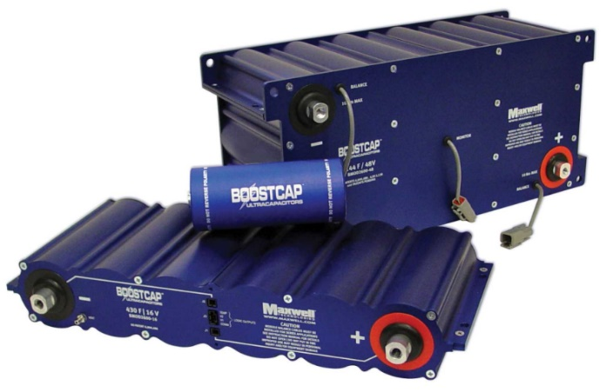
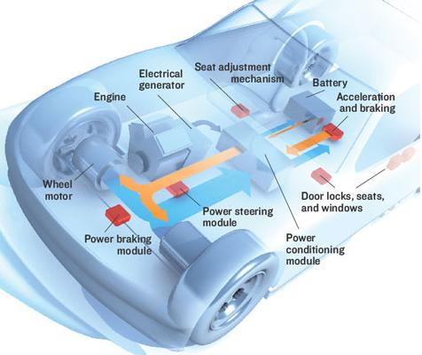
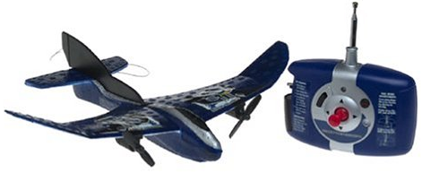
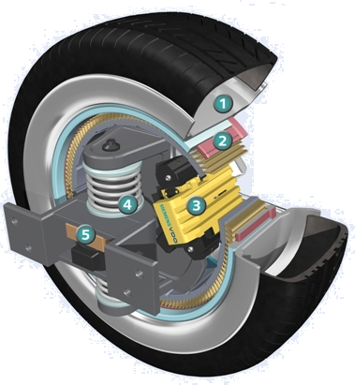
Applications for Supercapacitors
Back up for uninterruptable power supplies (UPS)
Light weight power supplies for small aircraft
Provide short duration power for various vehicle systems such as breaking or steering
Used to absorb power during short periods of generation such as Regenerative Braking
Extend range and battery life in Hybrid Electric Vehicles (HEV)

Slide 14
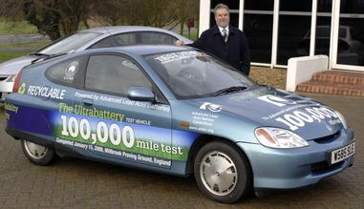
Hybrid Electric Vehicles
The CSIRO in Australia [national science agency] has developed the UltraBattery, which combines a supercapacitor and a lead acid battery in a single unit
4x longer life cycle, 50% more power, 70% cheaper than batteries used in HEV’s

Slide 15
Questions?

